Slide 1
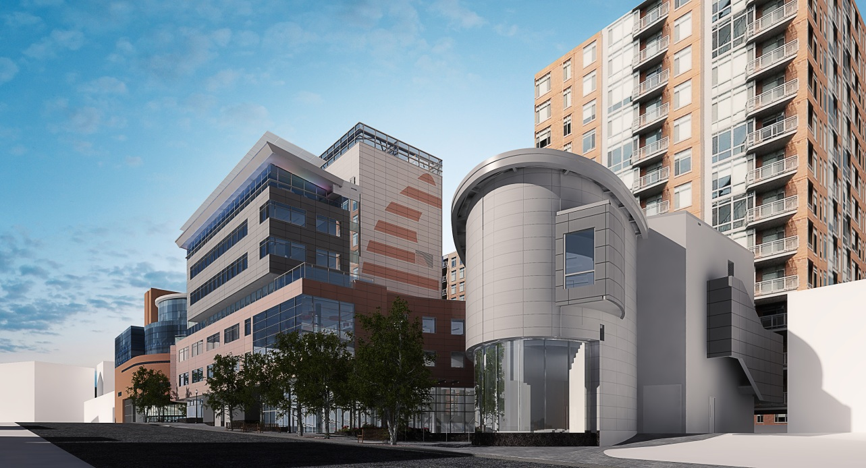
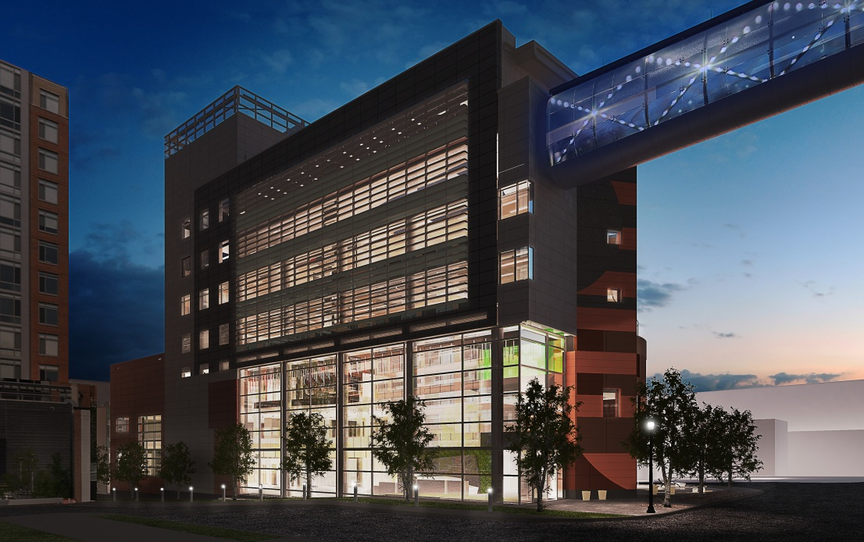
Introduction 120,000 SF 10 Stories (90ft) $40 Million Aug. 2010 – Dec.2011
Project Team
Owner: Health Research
Architect & Engineer:
General Contractor:
Presentation Outline
Introduction
Base Steel Redesign
Progressive Collapse
Tie Force
Alternative Path
Enhanced Local Resistance
Architectural Breadth
Conclusions

Slide 2
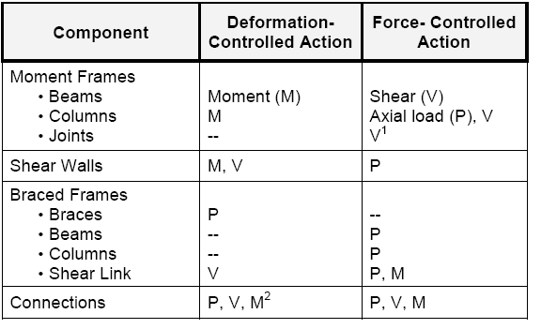
Progressive Collapse UFC 4-023: Typical Action Classifications
Alternative Path Analysis
Presentation Outline
Introduction
Base Steel Redesign
Progressive Collapse
Tie Force
Alternative Path
Enhanced Local Resistance
Architectural Breadth
Conclusions
Interaction Equation
Moment Divided by m-factor
Expected Strengths Used
Typical Frames = 6
$$\frac{Pr}{Ω∗Pc}+\frac{\frac{8}{9}\left[\frac{Mrx}{Ω∗Mcx}+\frac{Mry}{Ω∗Mcy}\right]}{m−factor}$$

Slide 3
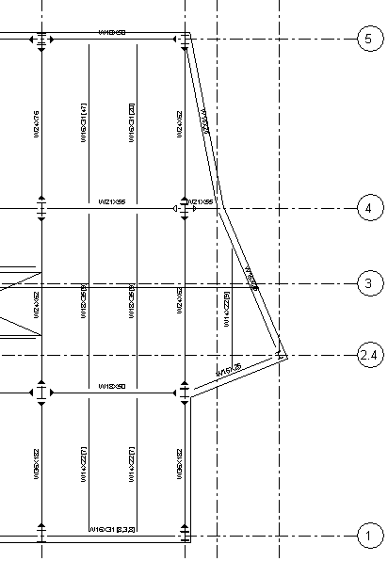
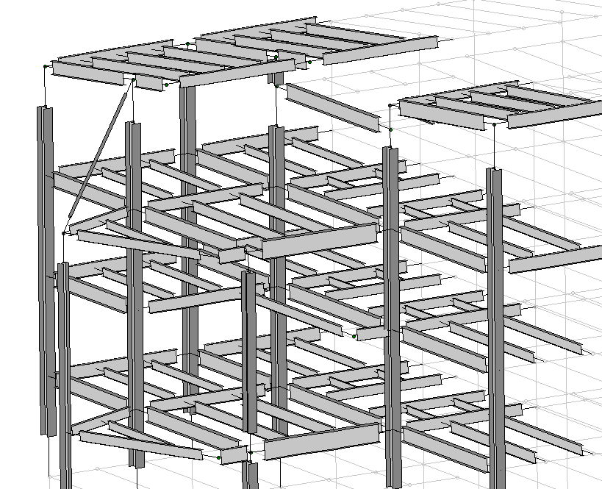
Progressive Collapse West Façade Column
Alternative Path Analysis
Presentation Outline
Introduction
Base Steel Redesign
Progressive Collapse
Tie Force
Alternative Path
Enhanced Local Resistance
Architectural Breadth
Conclusions

Slide 4
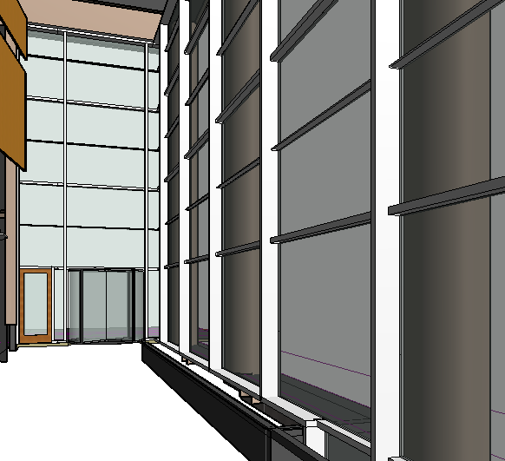
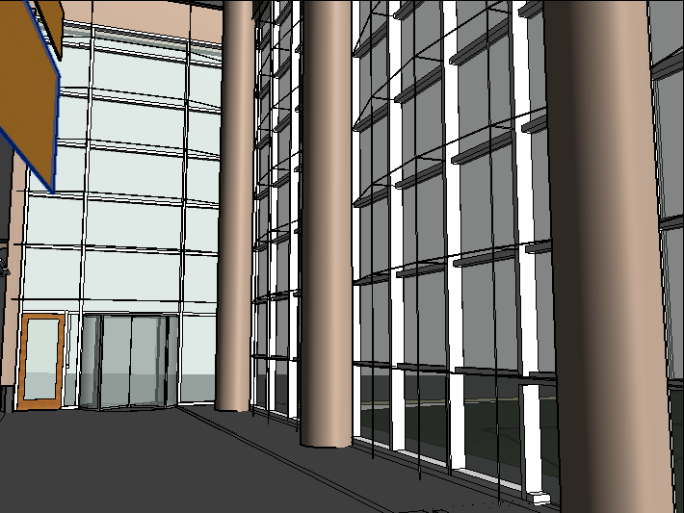
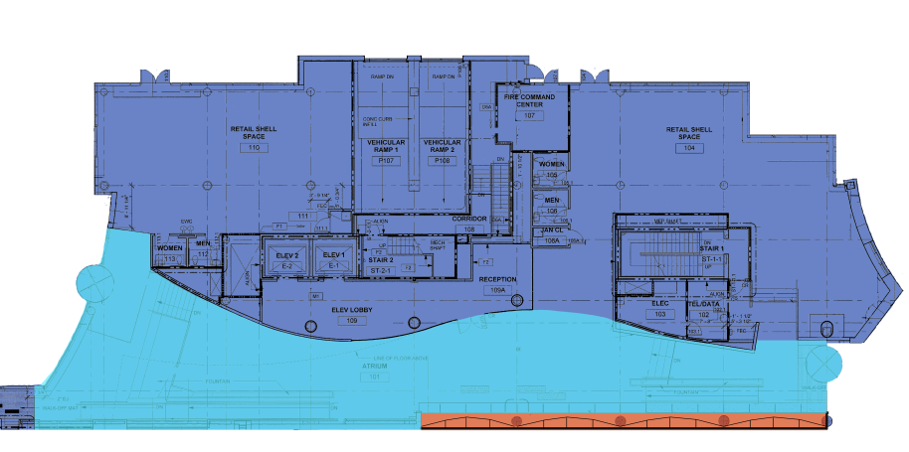
Architecture Breadth Existing Interior Atrium View
Atrium Curtain Wall
Redesigned Interior Atrium View
Presentation Outline
Introduction
Base Steel Redesign
Progressive Collapse
Tie Force
Alternative Path
Enhanced Local Resistance
Architectural Breadth
Conclusions

Slide 5
Conclusions Goals
Costs
Progressive Collapse Requirements
Slab Reinforcement: 596% Increase
Columns: 113% Increase
Beams: 9.9% Increase
Total Superstructure: 7.4% Increase
Presentation Outline
Introduction
Base Steel Redesign
Progressive Collapse
Tie Force
Alternative Path
Enhanced Local Resistance
Architectural Breadth
Conclusions
Design to UFC criteria
Explore impacts of this analysis
Minimal architectural impact

